Slide 1
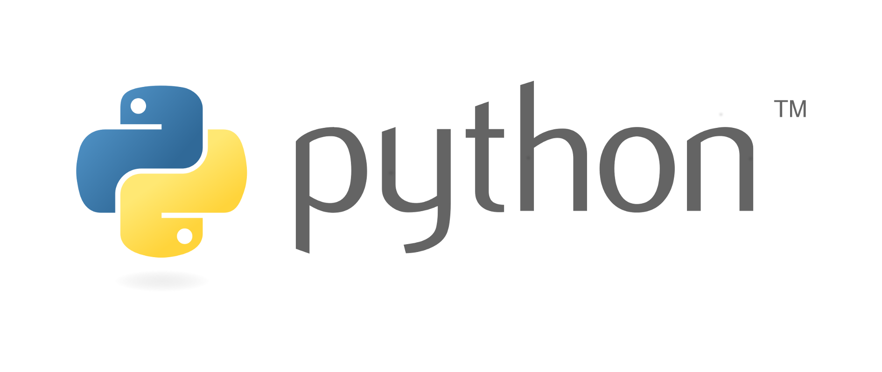
Tutorial 1: Python, Numpy, and AWS Tutorial
Hongyang Li
Jan 24, 2019
Slides credit by Tong Xiao

Slide 2
Python

Slide 3
Python Essentials
Readability
As efficient as possible
Be pythonic

Slide 4
Install Python 2.7
macOS:
Install homebrew (http://brew.sh/#install)
brew install python
Install modules
If it is in homebrew-python (https://github.com/Homebrew/homebrew-python)
Use brew to install it
Else
Use pip to install it
Linux and Windows:
Install Anaconda Python2.7 version (www.continuum.io/downloads)

Slide 5
Install IPython Notebook
Try in terminal: jupyter notebook
If not installed, run: pip install jupyter

Slide 6
Outline
Python basics
Numpy --- scientific computing
Matplotlib --- data visualization

Slide 7
What’s AWS?
A cloud server has GPU cards
Can be connected by ssh
Just like a server in your lab
Pricing at US$0.7 / hour
Reimburse at most US$20 for each registered student

Slide 8
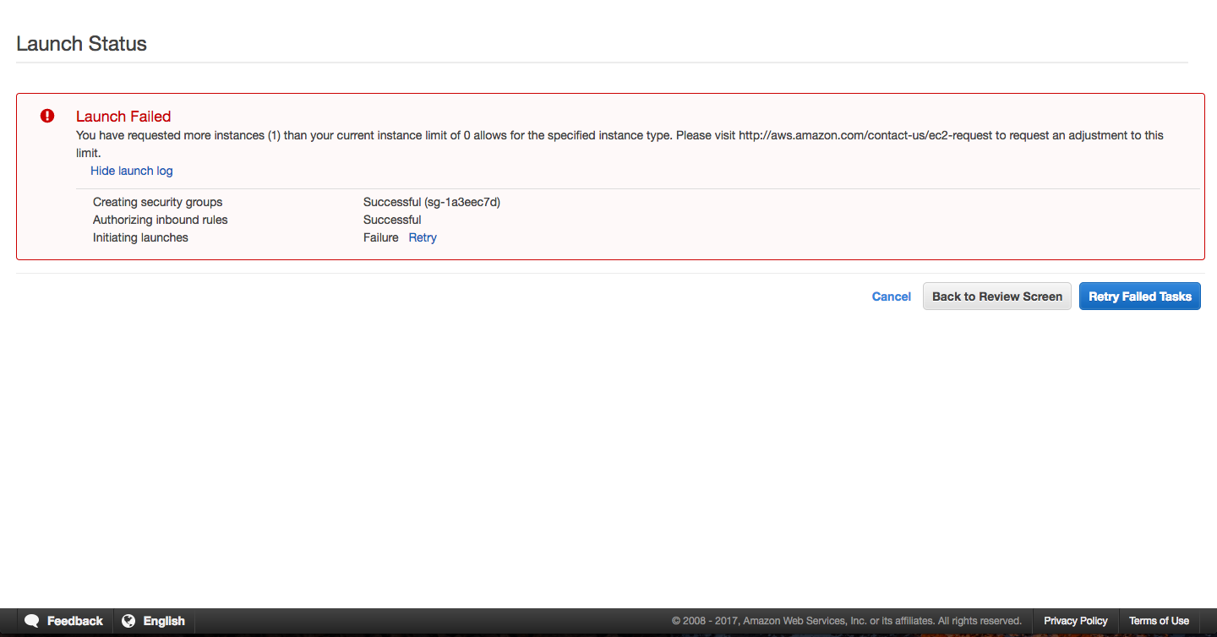
How to Use AWS?
Follow the instructions by cs231n (cs231n.github.io/aws-tutorial/)
May fail to launch a g2.2xlarge instance

Slide 9
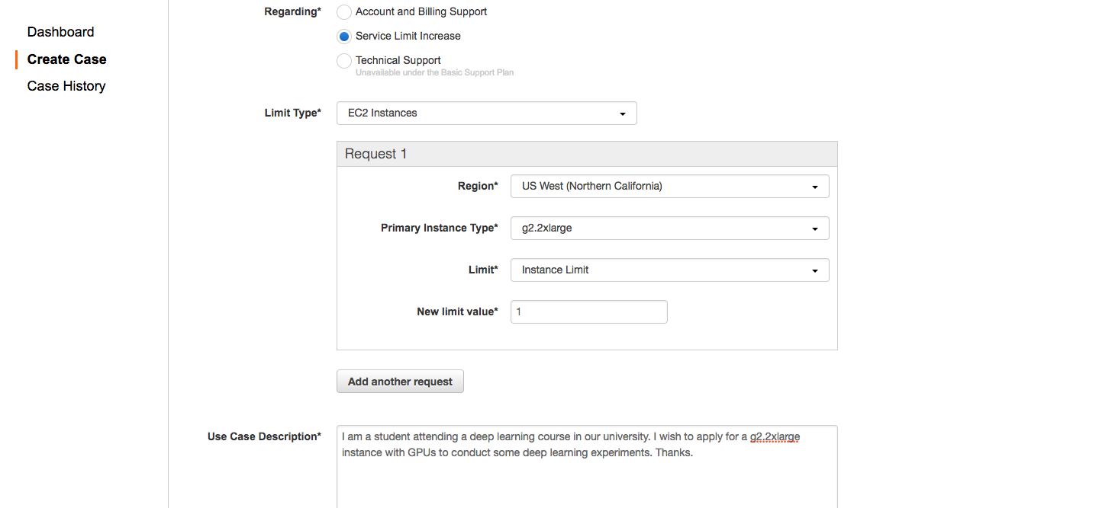
How to Use AWS?
Request for it and wait for 1-2 days

Slide 10
Thanks!

