Slide 1
Recent Advances in Generative Adversarial Networks (GAN)
ELEG 5491 Introduction to Deep Learning
Tutorial
Xihui Liu

Slide 2
Outline
Recap of generative adversarial networks
Projection discriminator
Self-attention GAN
BigGAN
StyleGAN
EdgeConnect
S³GAN
SPADE

Slide 3
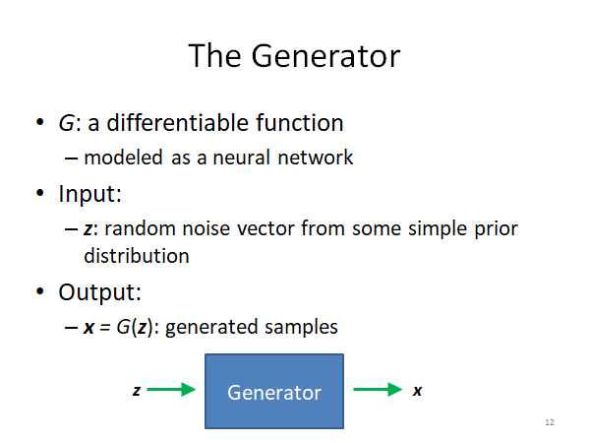
Recap

Slide 4
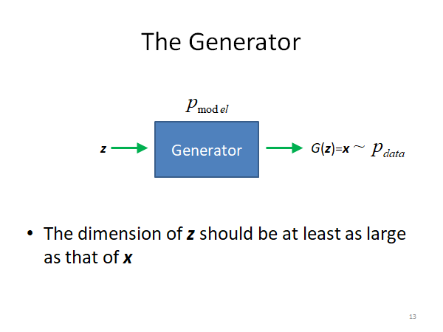

Slide 5
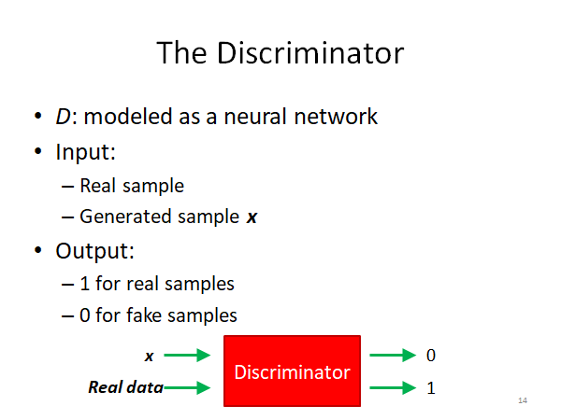

Slide 6
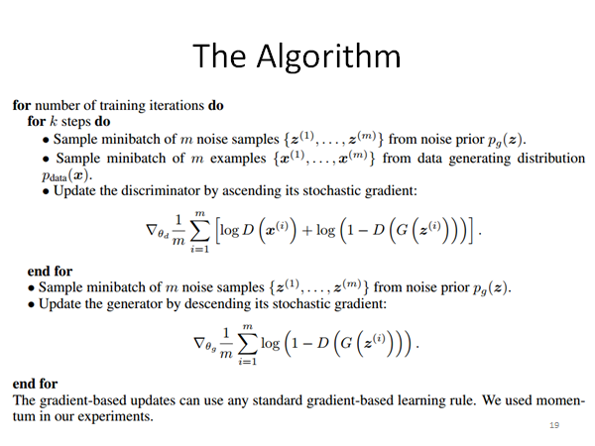

Slide 7
cGANs with Projection Discriminator
Takeru Miyato, Masanori Koyama

Slide 8
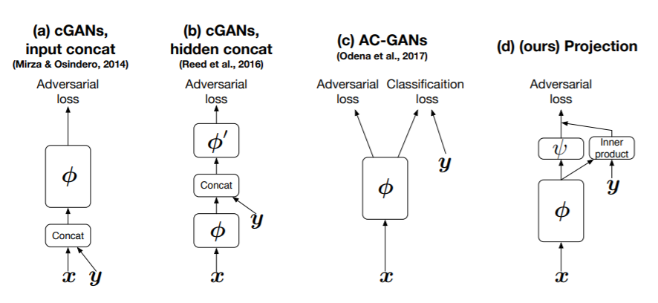
Discriminator Structure

Slide 9
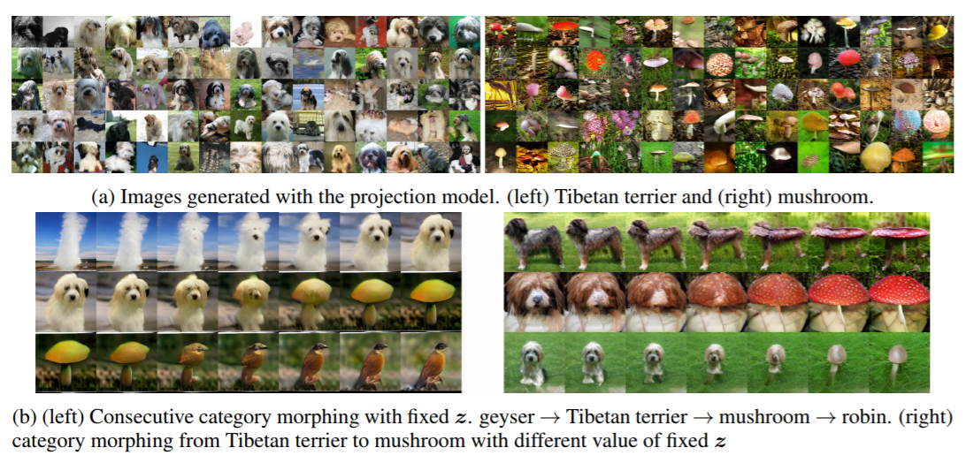
Results & Category morphing

Slide 10
Self-Attention Generative Adversarial Networks
Han Zhang, Ian Goodfellow, Dimitris Metaxas, Augustus Odena

Slide 11
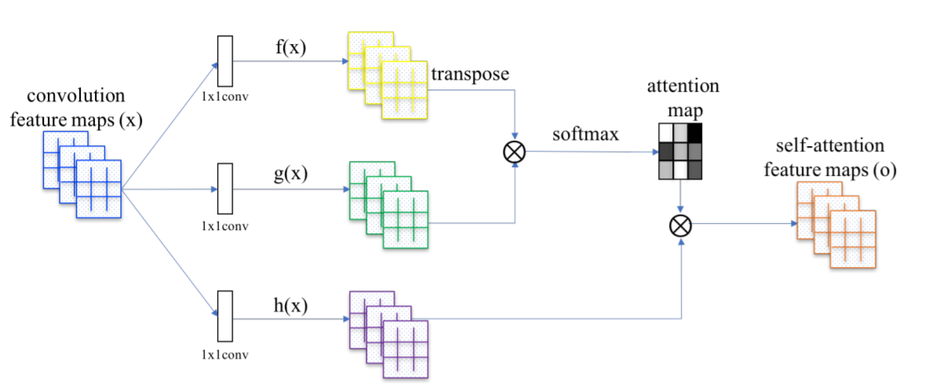
Self-Attention Structure

Slide 12
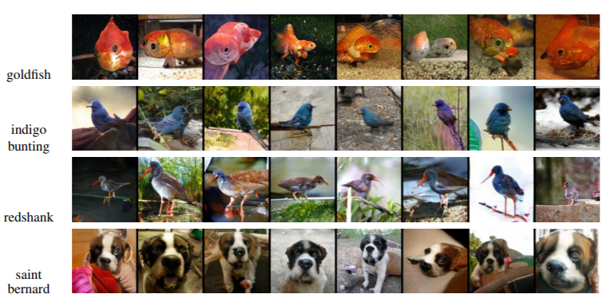
Techniques to stabilize GAN training
Spectral normalization for both generator and discriminator
Imbalanced learning rate for generator and discriminator updates

Slide 13
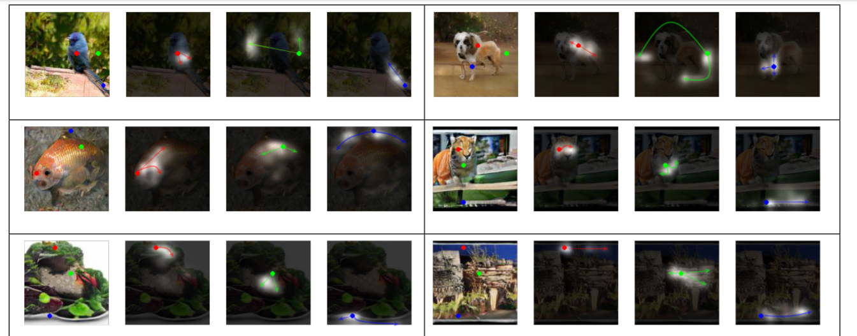
Visualize self-attention

Slide 14
Large Scale GAN Training for High Fidelity Natural Image Synthesis
Andrew Brock, Jeff Donahue, Karen Simonyan
https://www.youtube.com/watch?v=ZKQp28OqwNQ

Slide 15
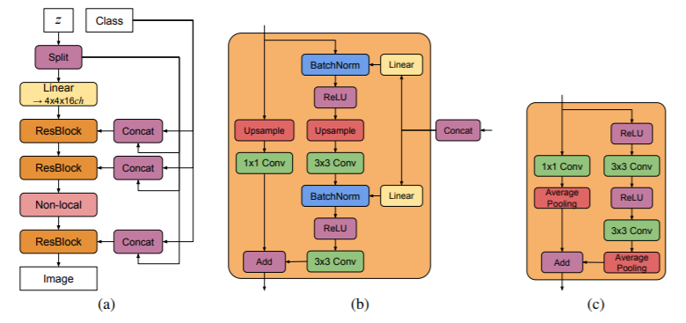
Model Structure

Slide 16

Techniques
Increase batch size by a factor of 8 ---> IS increases by 46%
Increased channel width ---> IS further increases by 21%
Increased depth ---> BigGAN-deep
Shared class embedding for conditional Batch-norm.
Skip connections to multiple layers of generator.
Truncation trick -- trading off the variety and fidelity.
Orthogonal regularization
Extensive experiments

Slide 17
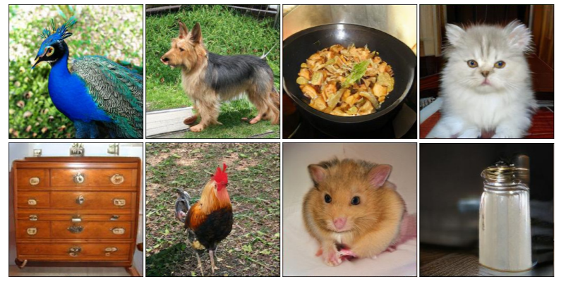
Results

Slide 18
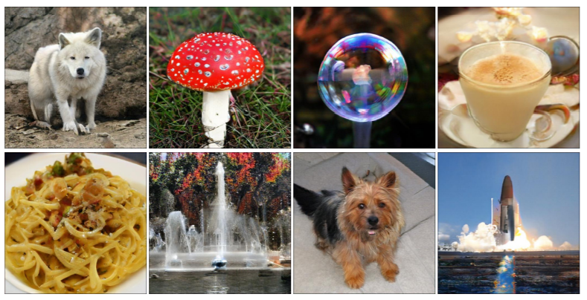
Results

Slide 19
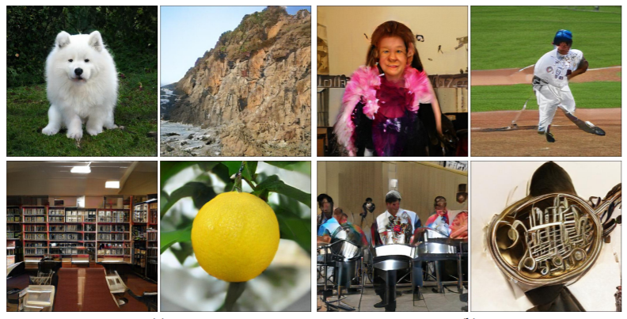
Easy Classes and Difficult Classes

Slide 20
A Style-Based Generator Architecture for Generative Adversarial Networks
Tero Karras, Samuli Laine, Timo Aila
https://www.youtube.com/watch?v=-cOYwZ2XcAc&t=21s

Slide 21
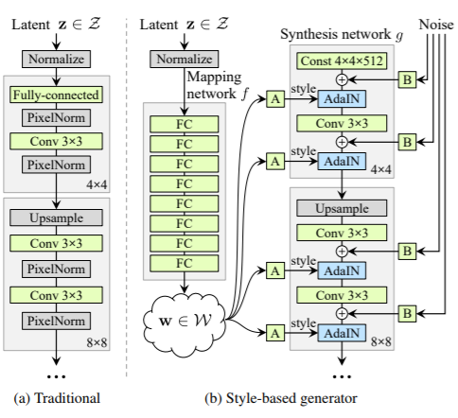

Network Architecture
Adaptive IN

Slide 22
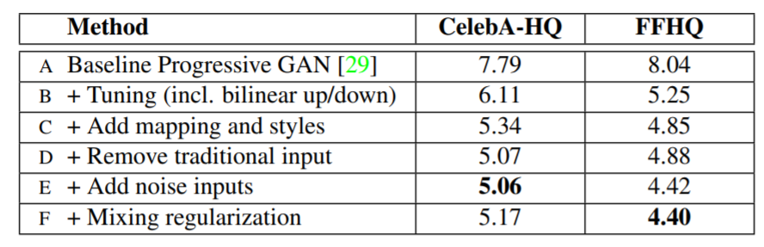
Building up the Model

Slide 23
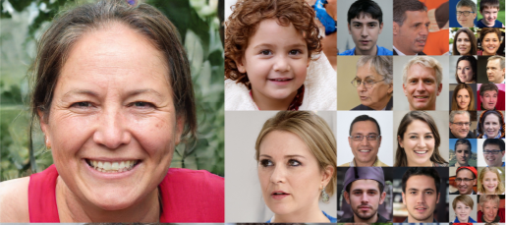
Results -- faces

Slide 24
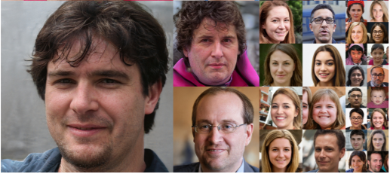
Results -- faces

Slide 25
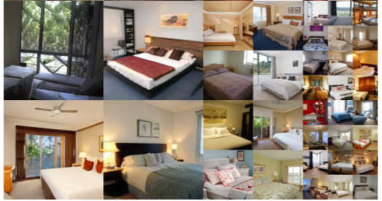
Results -- bedrooms

Slide 26
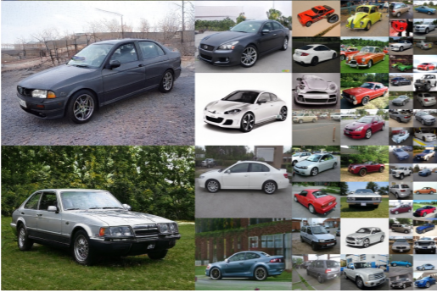
Results -- cars

Slide 27
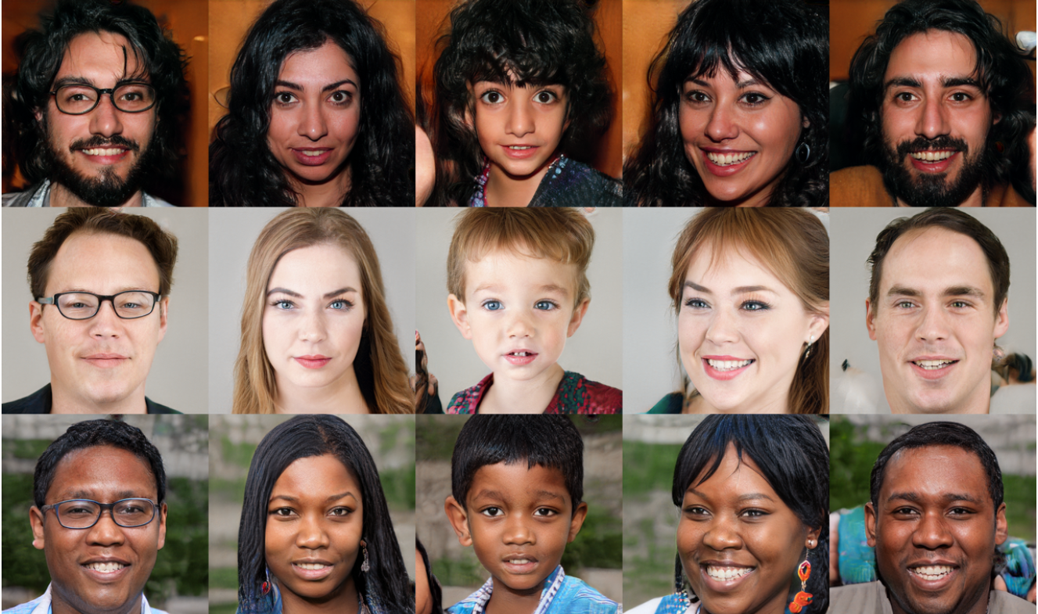
A Style-Based Generator Architecture for Generative Adversarial Networks

Slide 28
Semantic Image Synthesis with Spatially-Adaptive Normalization
Taesung Park, Ming-Yu Liu, Ting-Chun Wang, Jun-Yan Zhu

Slide 29
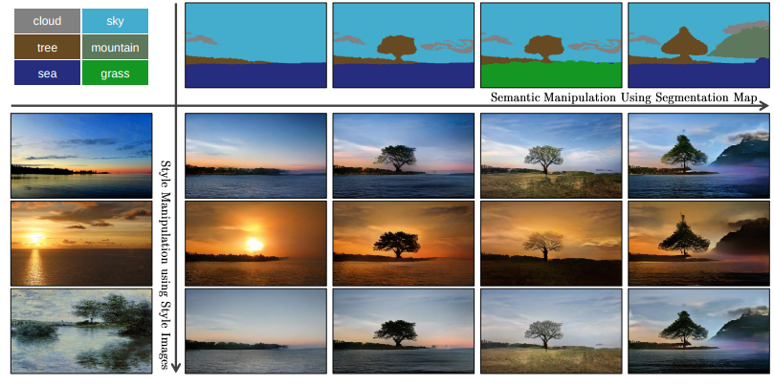
Image Synthesis from Semantic Segmentation Masks

Slide 30
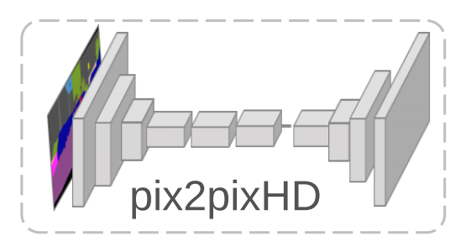
Previous approaches: pix2pixHD
Directly feed the semantic layout as input to the deep network, which is processed through stacks of convolution, normalization, and nonlinearity layers.
However, this is suboptimal as the normalization layers tend to “wash away” semantic information in input semantic segmentation masks.

Slide 31
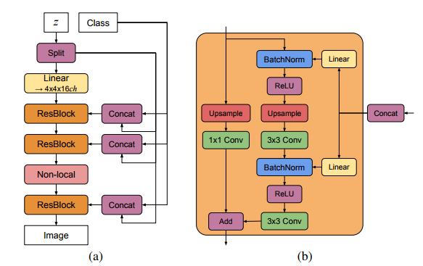
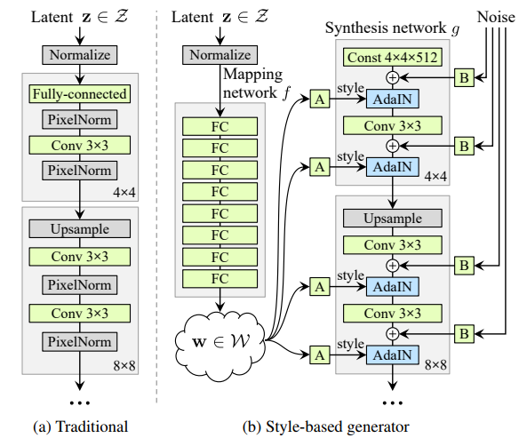
Conditional Normalization Layers
Proven effective for recent generative adversarial networks such as Self-attention GAN, BigGAN, StyleGAN, etc.

Slide 32
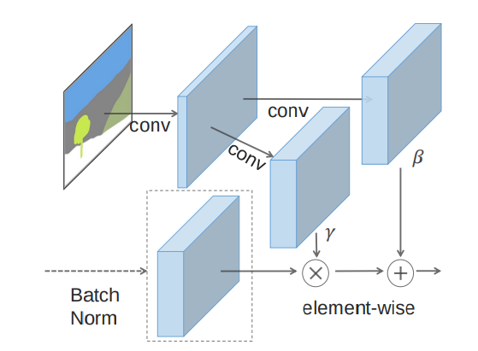

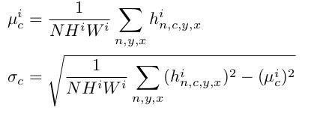
SPADE: spatially-adaptive denormalization

Slide 33
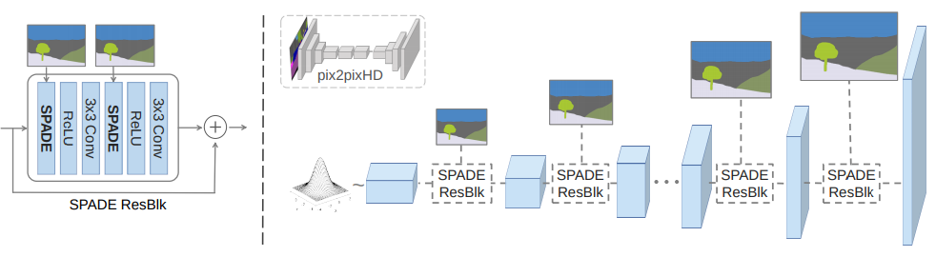
SPADE Generator

Slide 34
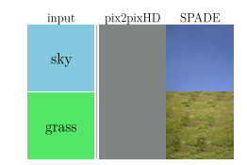
SPADE Generator
Better preserve semantic information against common normalization layers.
The conventional normalization layers tend to “wash away” semantic information in input semantic segmentation masks.

Slide 35
Details
Multi-modal synthesis with an image encoder and a KL-Divergence loss.
Discriminator is the same as pix2pixHD.
Datasets
  COCO-Stuff
  ADE20K
  ADE20K-outdoor
  Cityscapes
  Flickr Landscapes

Slide 36
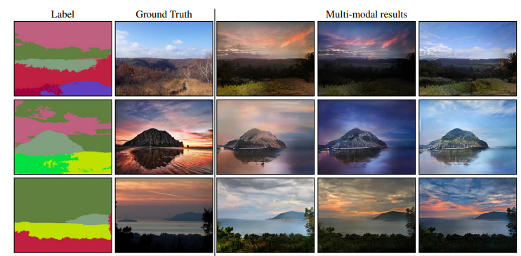
Results

Slide 37
EdgeConnect: Generative Image Inpainting with Adversarial Edge Learning
Kamyar Nazeri, Eric Ng, Tony Joseph, Faisal Z. Qureshi, Mehran Ebrahimi

Slide 38
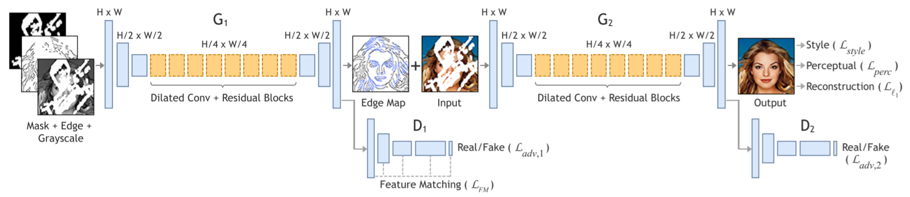
Network Structure
Edge generator
Image completion network

Slide 39
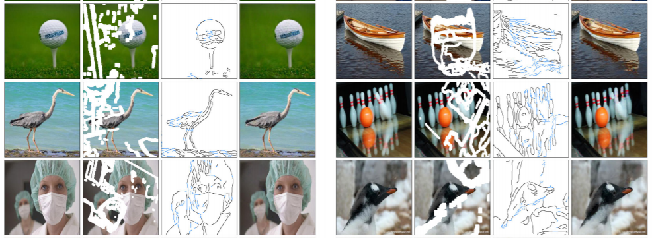
Results

Slide 40
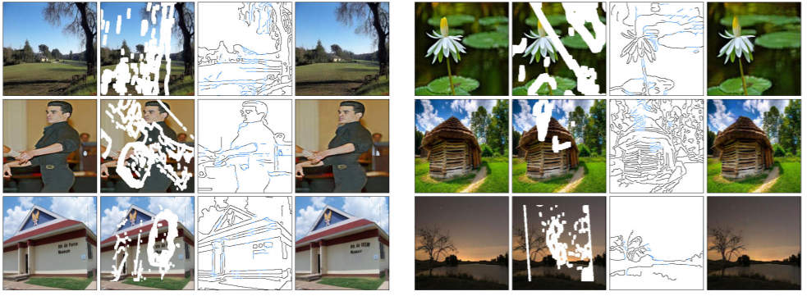
Results

Slide 41
SC-FEGAN: Face Editing Generative Adversarial Network with User's Sketch and Color
Youngjoo Jo, Jongyoul Park
https://www.youtube.com/watch?v=dvzlvHNxdfI

Slide 42
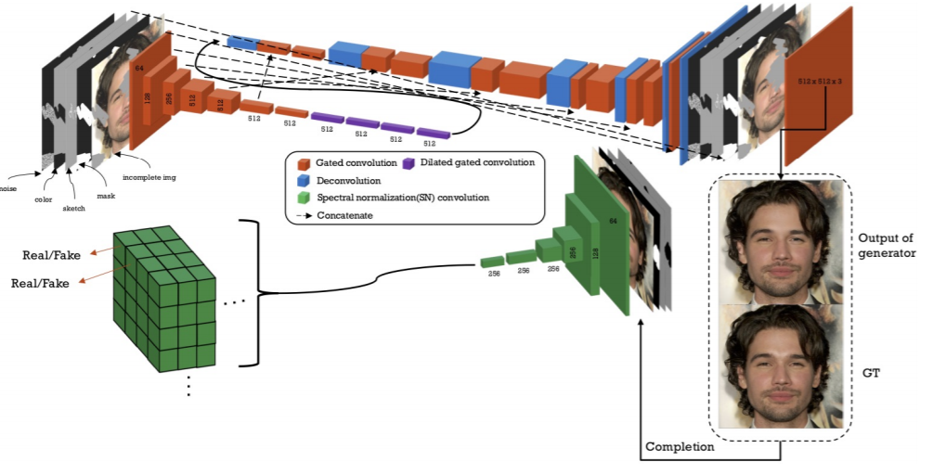

Slide 43
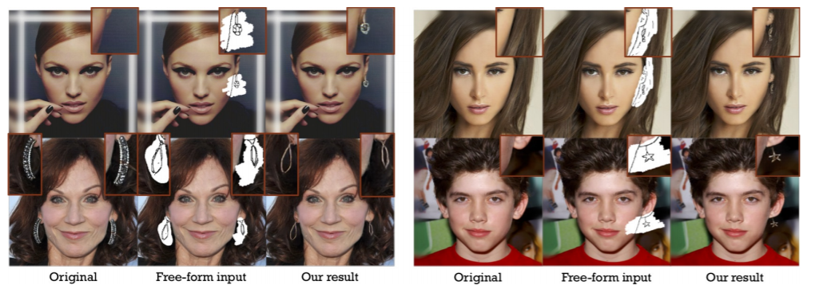
Results

Slide 44
High-Fidelity Image Generation With Fewer Labels
Mario Lucic, Michael Tschannen, Marvin Ritter, Xiaohua Zhai, Olivier Bachem, Sylvain Gelly

Slide 45
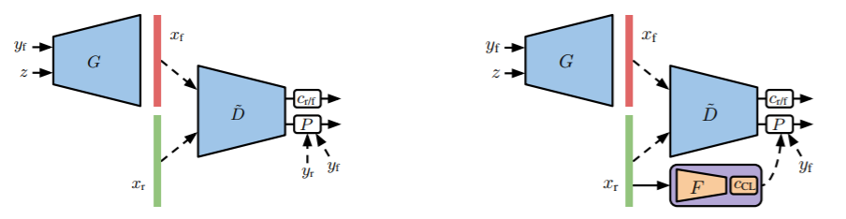
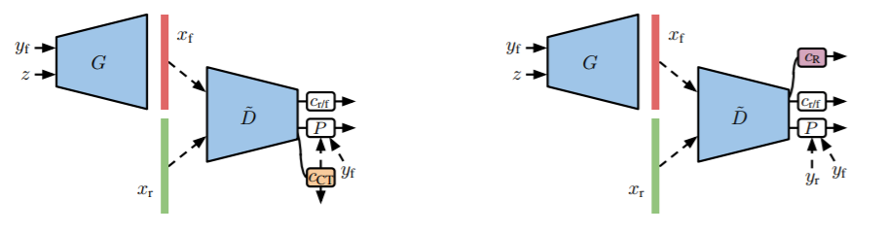
High-Fidelity Image Generation With Fewer Labels

Slide 46
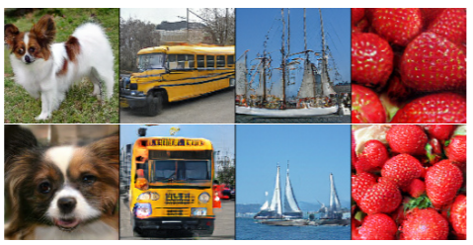
High-Fidelity Image Generation With Fewer Labels

