Slide 1
Walking Through Specific
Model Designs
ELEG5491: Introduction to Deep Learning
Hang Zhou

Slide 2
Table of Contents
U-Net
Multiple Layers Refinement
Feature Pyramid
Applications

Slide 3
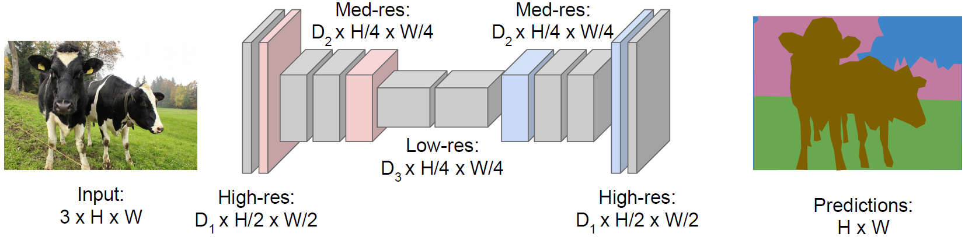
Review: Semantic Segmentation
Downsampling:
Pooling, strided
convolution
Design network as a bunch of convolutional layers, with downsampling and upsampling inside the network!
Upsampling:
???
Apply cross-entropy loss at every pixel
of the predicted label map
Long, Shelhamer, and Darrell, “Fully Convolutional Networks for Semantic Segmentation”, CVPR 2015
Noh et al, “Learning Deconvolution Network for Semantic Segmentation”, ICCV 2015

Slide 4
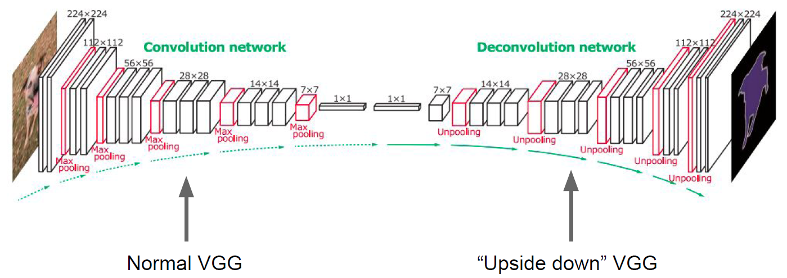
Review: Encoder-decoder (w/o shortcut)
Used unpooling but not “deconvolution”
In practice, “deconvolution” is better
Noh et al, “Learning Deconvolution Network for Semantic Segmentation”, ICCV 2015

Slide 5
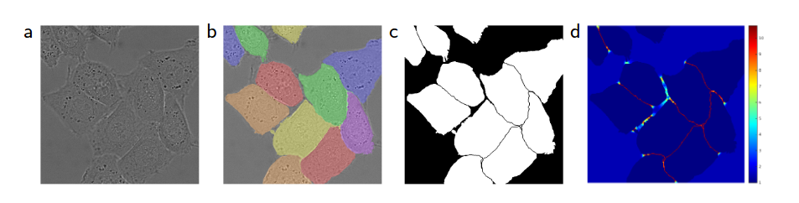
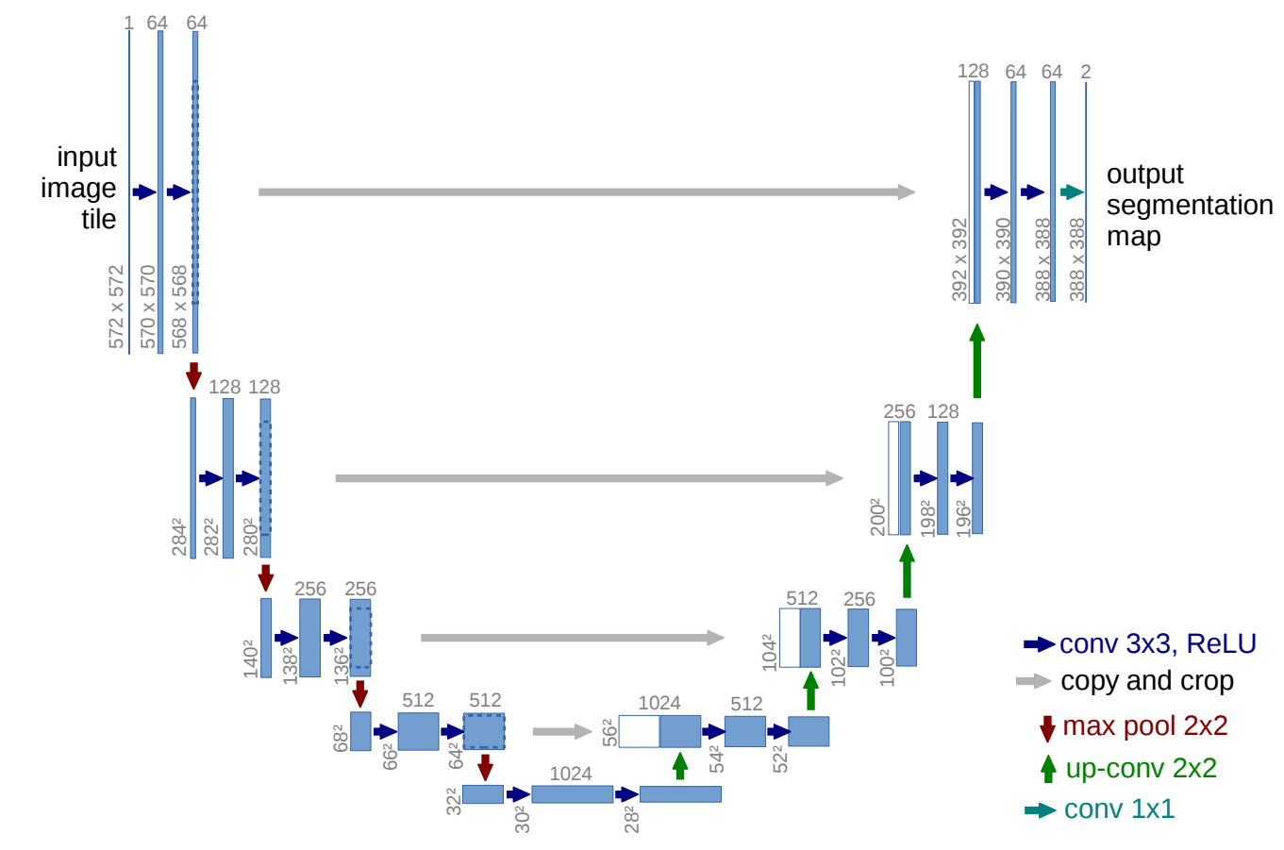
U-Net: an encoder-decoder with shortcuts
U-Net: Convolutional Networks for Biomedical Image Segmentation. MICCAI 2015

Slide 6
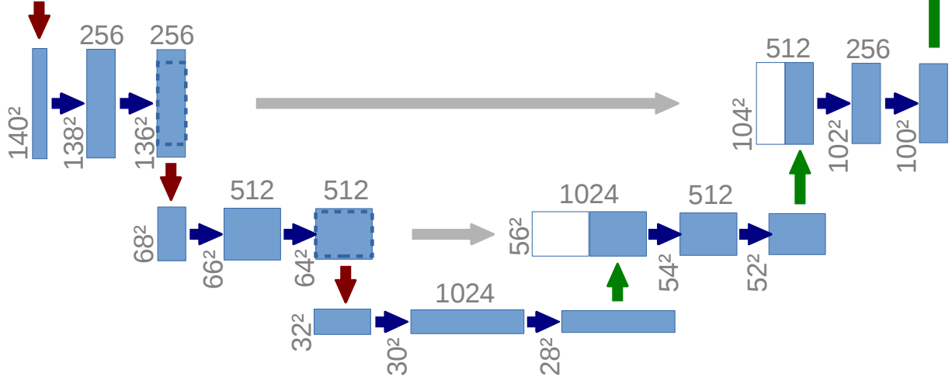
Original U-Net features
FCN: fully convolutional network for segmentation.
a concatenation with the correspondingly cropped feature map from the contracting path. (skip connection)
Computationally efficient. (Encoder-Decoder)
Combines the location information from the downsampling path with the contextual information in the upsampling path.

Slide 7
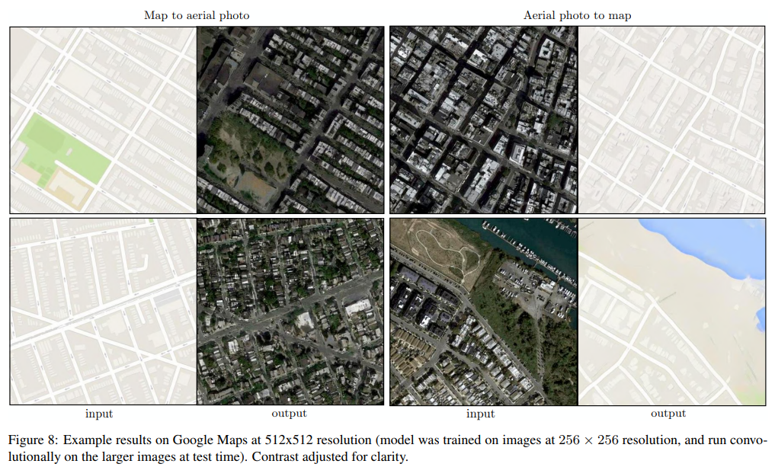
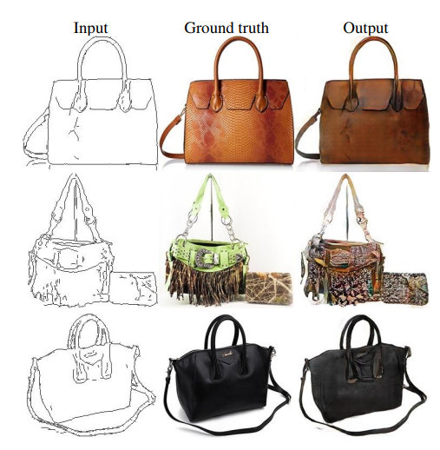
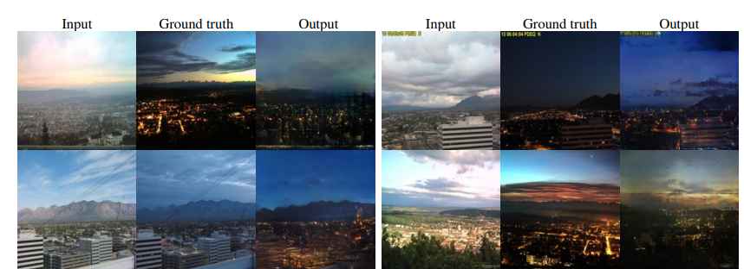
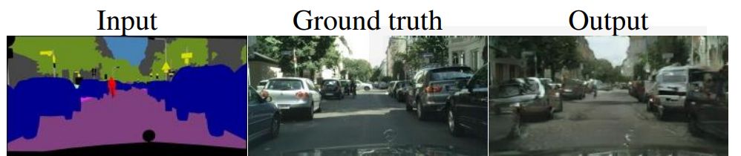
Image-to-Image Translation
“Translating” an input image into a corresponding output image

Slide 8
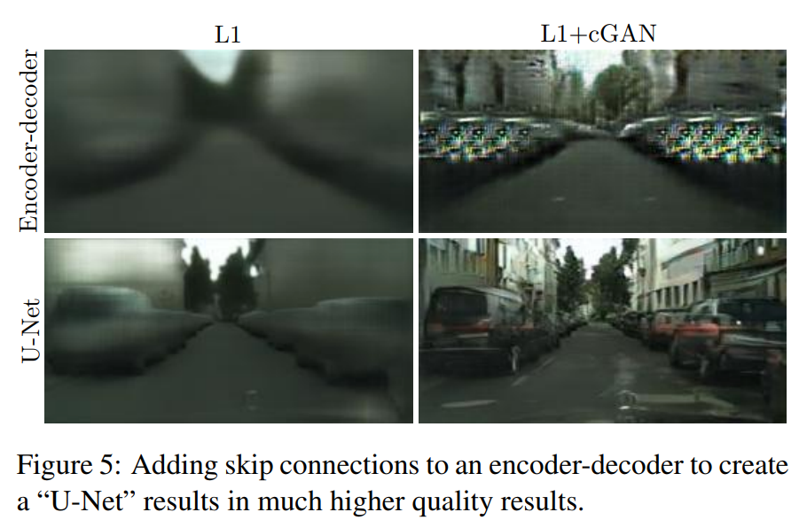
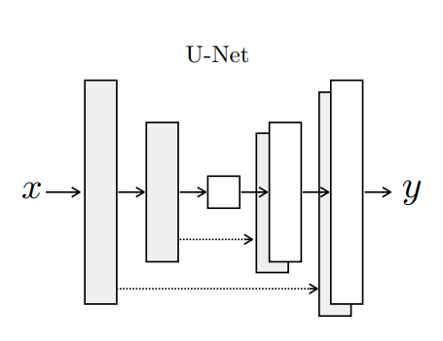
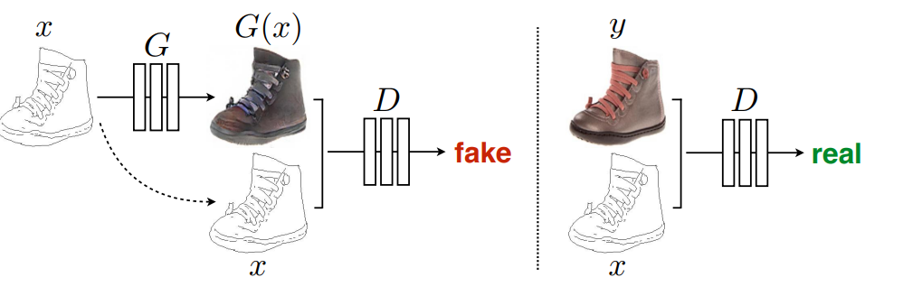
U-Net for Image Translation
U-Net with GANs
e.g. from segmantation masks to real images
See code for more details!
Image-to-Image Translation with Conditional Adversarial Networks. CVPR 2017

Slide 9
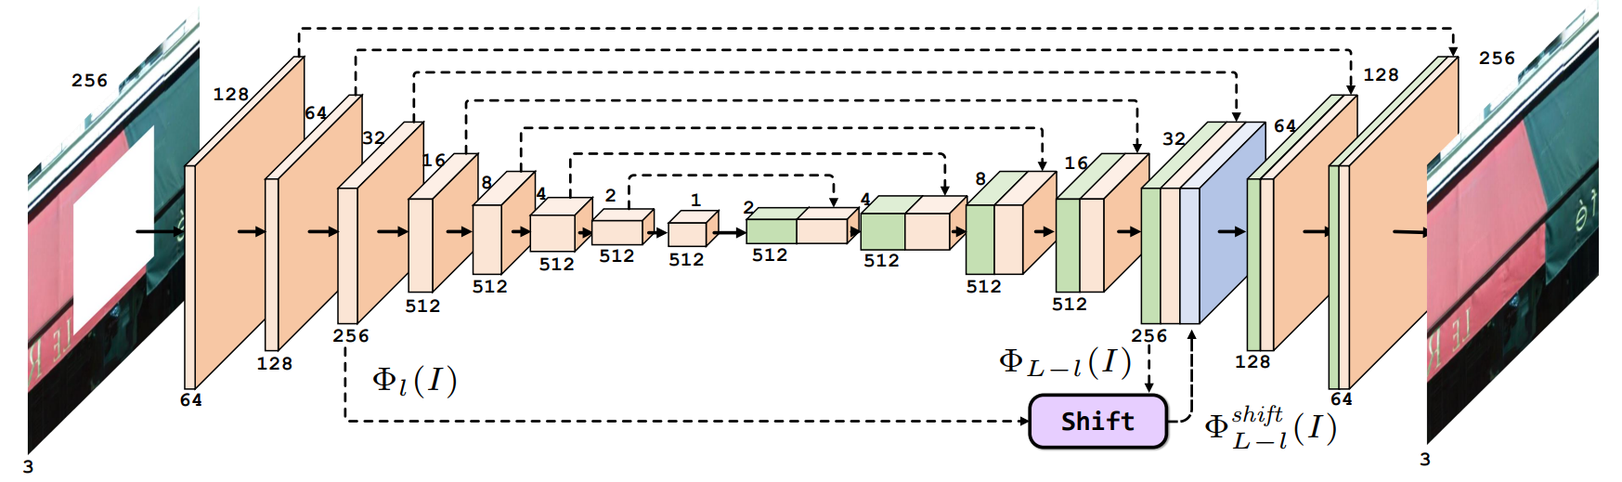
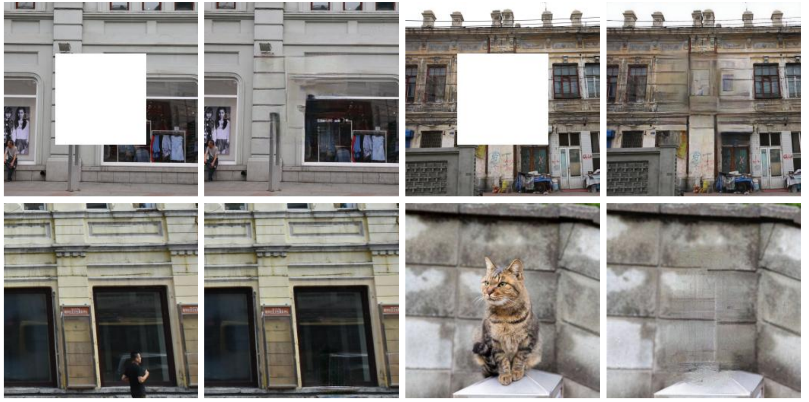
U-Net for Image Inpainting
U-Net with exemplar-based method for inpainting
Context Encoders: Feature Learning by Inpainting. CVPR 2016
Shift-Net: Image Inpainting via Deep Feature Rearrangement. ECCV 2018

Slide 10
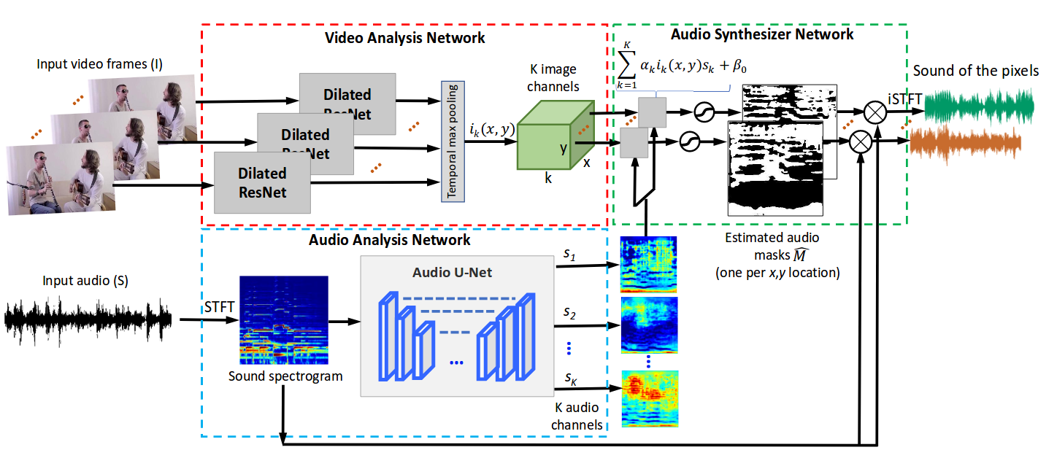
U-Net for Source Separation
U-Net operates on spectrograms for audio source separation,
and combines with vision masks for visual grounding
The Sound of Pixels. ECCV 2018

Slide 11
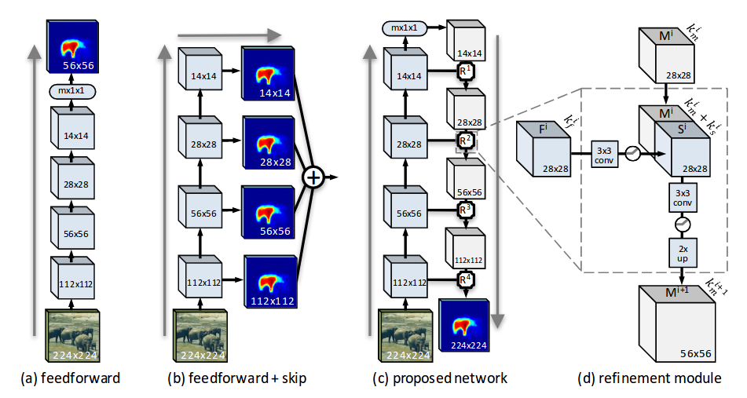
Learning to Refine Object Segments
Skip connection with refinement module for segmentation
Learning to Refine Object Segments. ECCV 2016

Slide 12
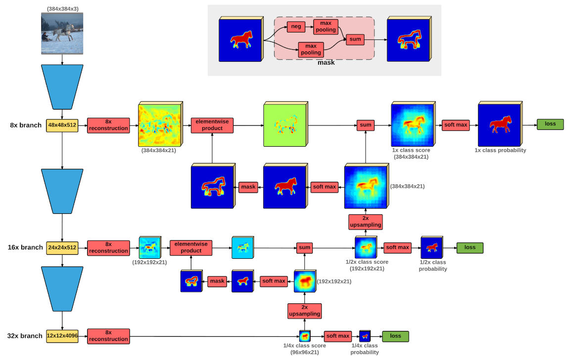
Pyramid Refinement for Segmentation
Laplacian Pyramid Reconstruction and Refinement for Semantic Segmentation. ECCV 2016

Slide 13
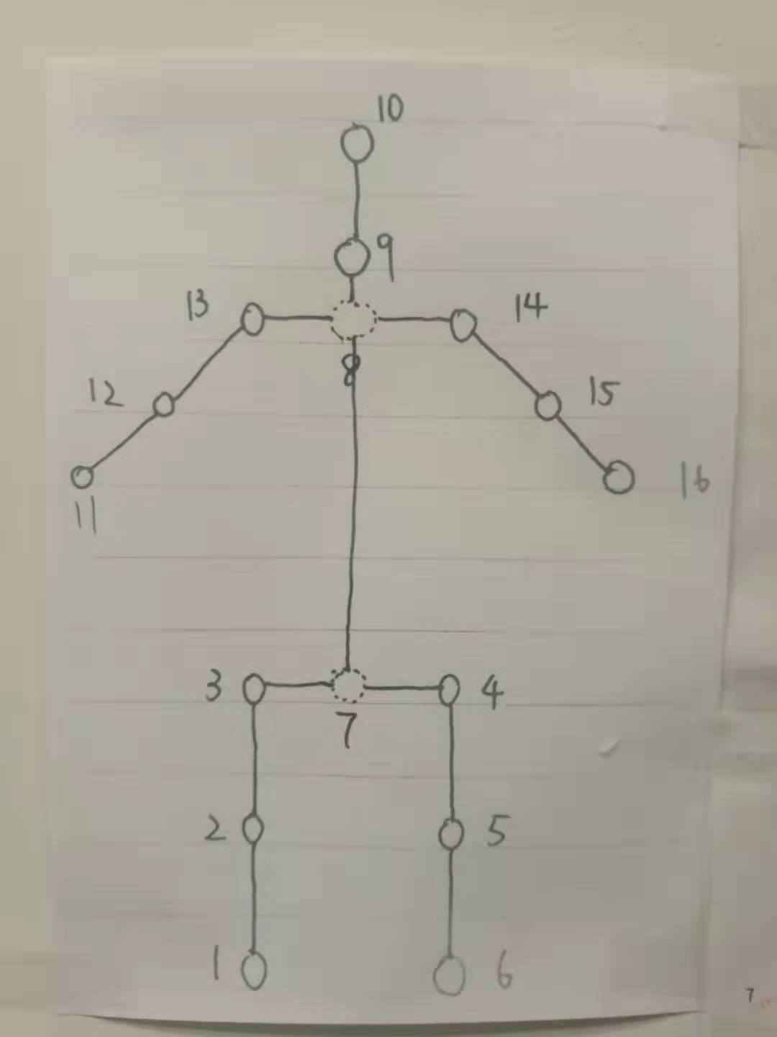
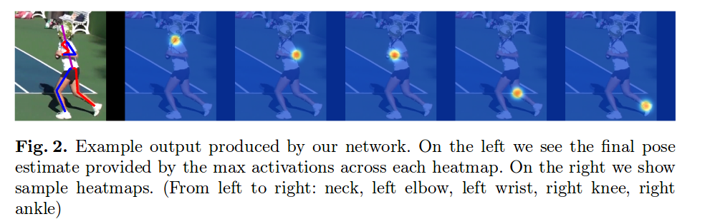
Human Pose Estimation
Given a single RGB image, we wish to determine the precise pixel location of important keypoints of the body.
Useful higher level tasks like action recognition, and also serves as a fundamental tool in fields such as human-computer interaction and animation

Slide 14
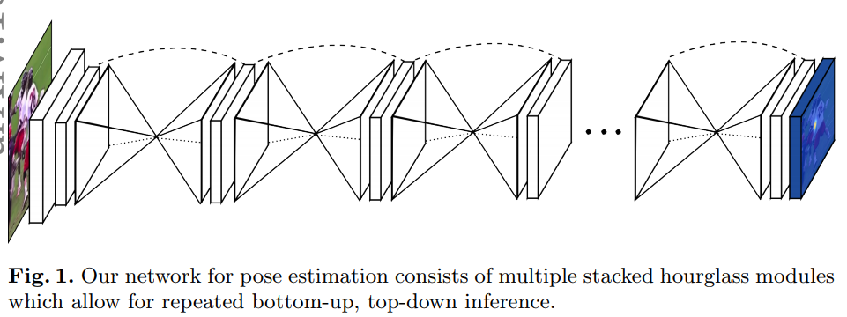
Stacked Hourglass for Human Pose Estimation
The network captures and consolidates information across all scales of the image.
This allows for repeated bottom-up, top-down inference across scales
Stacked Hourglass Networks for Human Pose Estimation. ECCV 2016

Slide 15
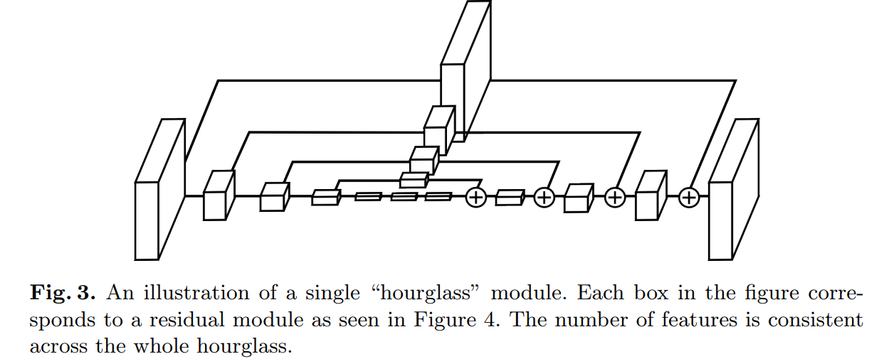
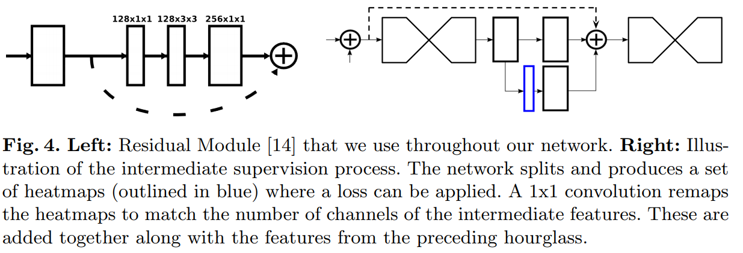
Stacked Hourglass for Human Pose Estimation
Layer Implementation
Intermediate Supervision

Slide 16
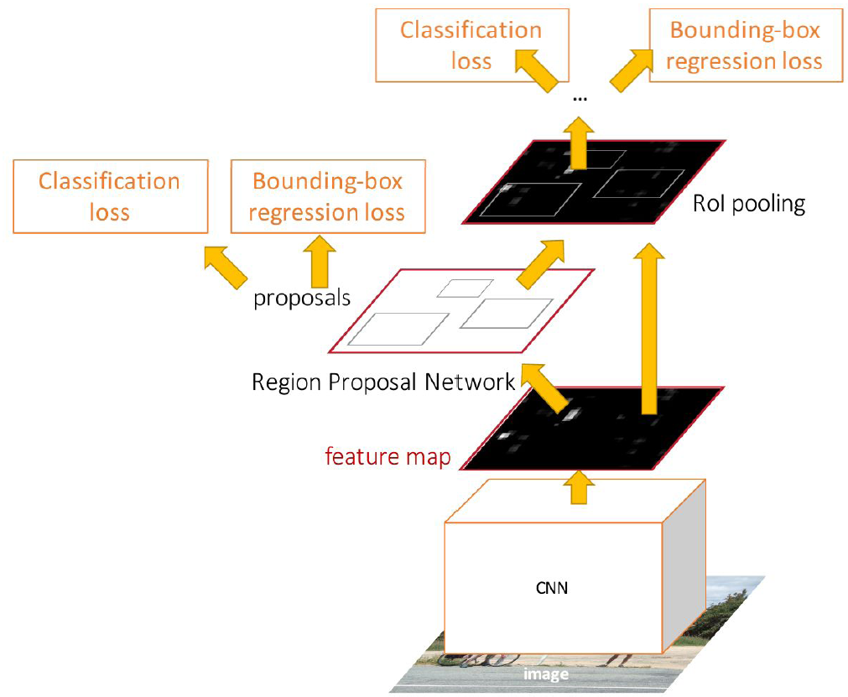
Review: Faster R-CNN
Make CNN do proposals!
Insert Region Proposal Network (RPN) to predict proposals from features
Jointly train with 4 losses:
  RPN classify object / not object
  RPN regress box coordinates
  Final classification score (object classes)
  Final box coordinates
Ren et al, “Faster R-CNN: Towards Real-Time Object Detection with Region Proposal Networks”, NIPS 2015

Slide 17
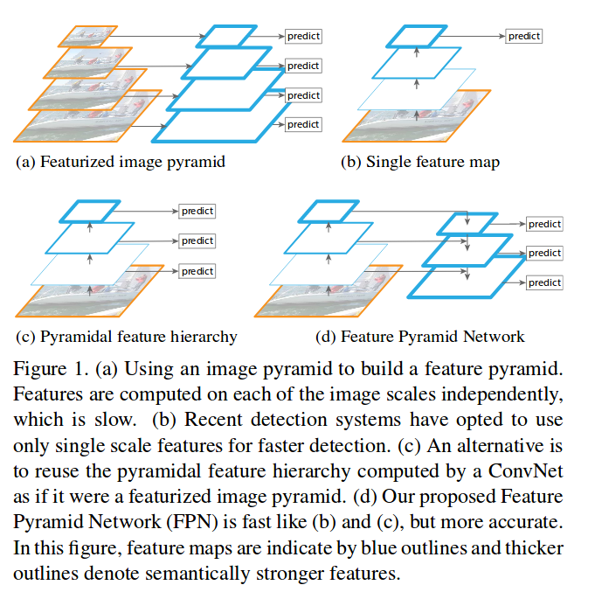
Feature Pyramid Networks for Object Detection
Aim: to recognize objects at vastly different scales.
Pyramids are scale-invariant: an object’s scale change is offset by shifting its level in the pyramid.
Combines low-resolution, semantically strong features with high-resolution, semantically weak features via a top-down pathway and lateral connections.
Feature Pyramid Networks for Object Detection. CVPR 2017

Slide 18
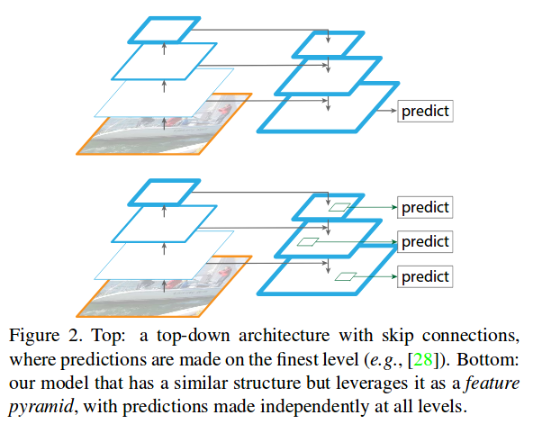
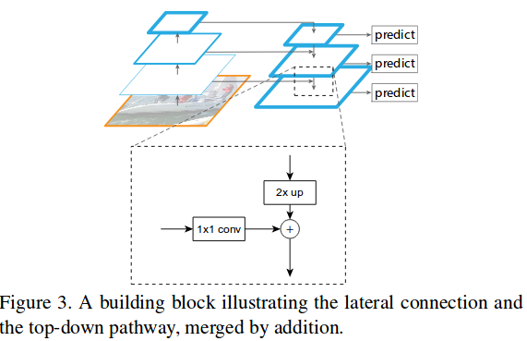
Feature Pyramid Networks for Object Detection
Bottom-up pathway. The bottom-up pathway is the feed-forward computation of the backbone ConvNet
Top-down pathway and lateral connections. The top-down pathway hallucinates higher resolution features by upsampling spatially coarser.
Predictions are independently made on each level.

Slide 19
Common Features
Encoder-Decoder with skip connections.
Operating at different feature / image scales.
Appliable for almost all pixel level prediction tasks:
  Segmentation
  Detection
  Optical flow
  Depth and disperity
  Image translation
  Video interpolation
  Voice convertion
  Speech separation
  All kinds of low-level vision problems
  and many more...

Slide 20
Adventages
Spatial information lost during maxpooling can in part be recovered by unpooling and deconvolution
Activation maps at lower-levels of the CNN hierarchy contain higher spatial resolution information.
Objects at different scales can be handled.
Searching space of the following modules can be reduced.

Slide 21
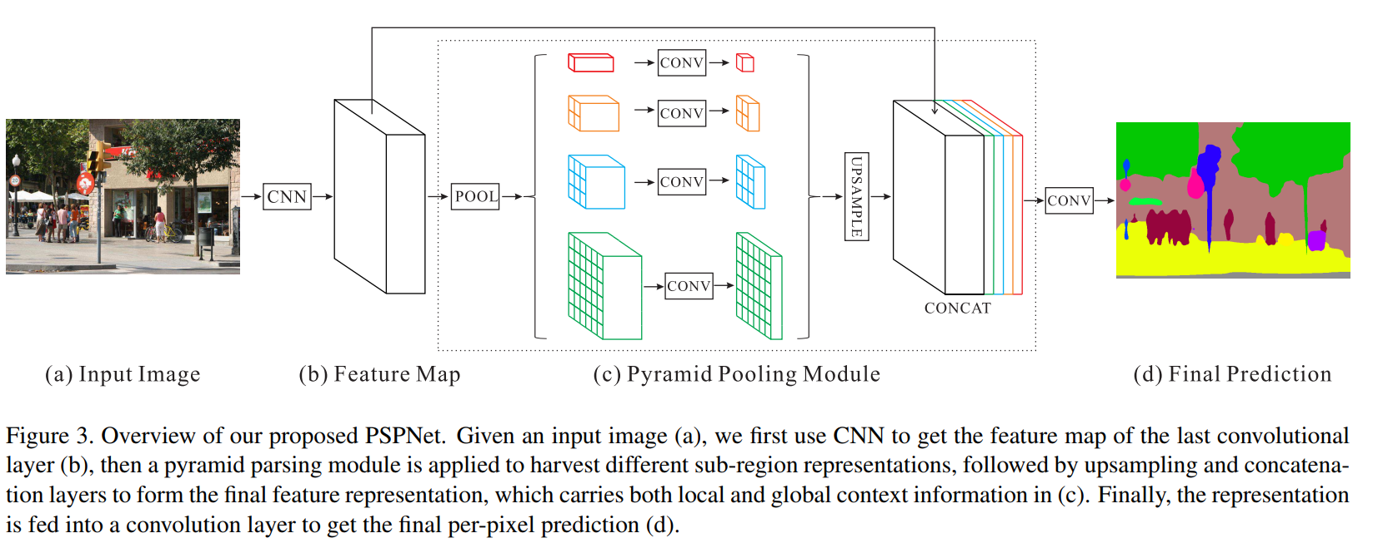
Pyramid for Scene Parsing
Scene Parsing is the strictly segmentation approach to scene labeling. For semantic segmentation, the algorithm is intended to segment only the objects it knows.
Pyramid Scene Parsing Network. CVPR 2016

Slide 22
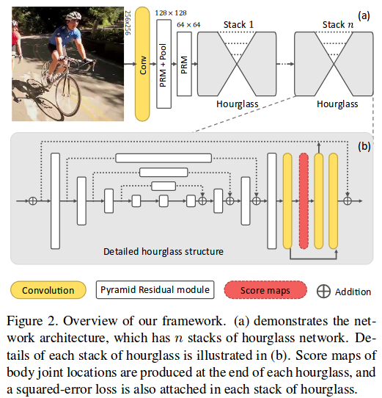
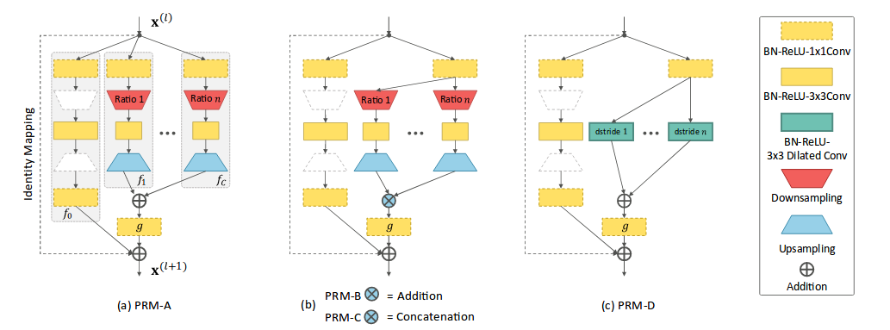
Feature Pyramids with Hourglass for Pose Estimation
Tackle scale variations of human body parts when camera view changes or severe foreshortening happens.
Propose Pyramid Residual Module, which enhances the invariance in scales of deep models by learning feature pyramid.
Learning Feature Pyramids for Human Pose Estimation. ICCV 2017

Slide 23
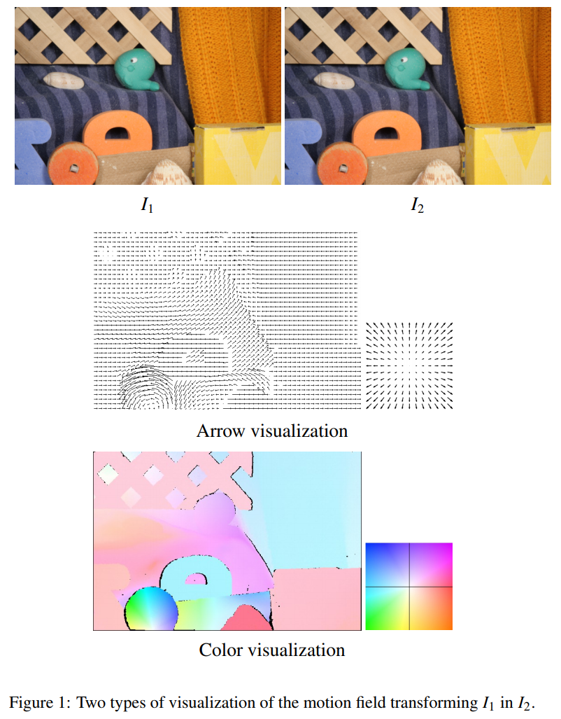
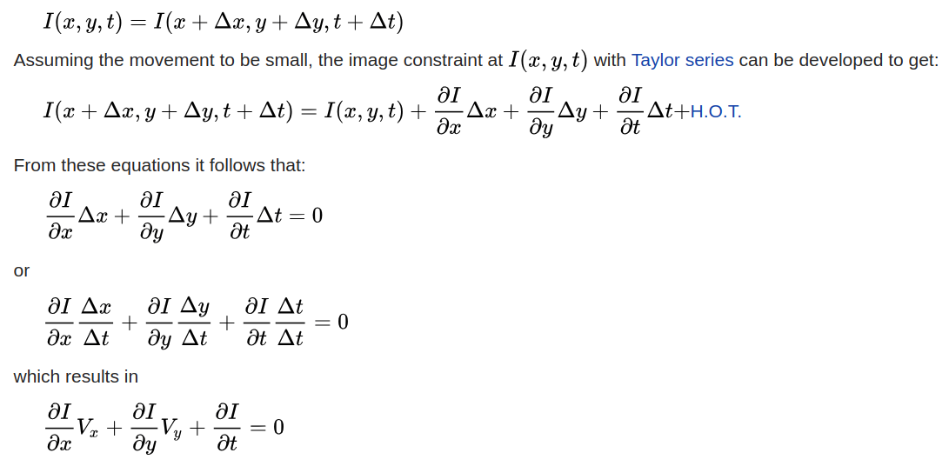
Optical Flow Computing
The notion of optical flow literally refers to the displacements
of intensity patterns

Slide 24
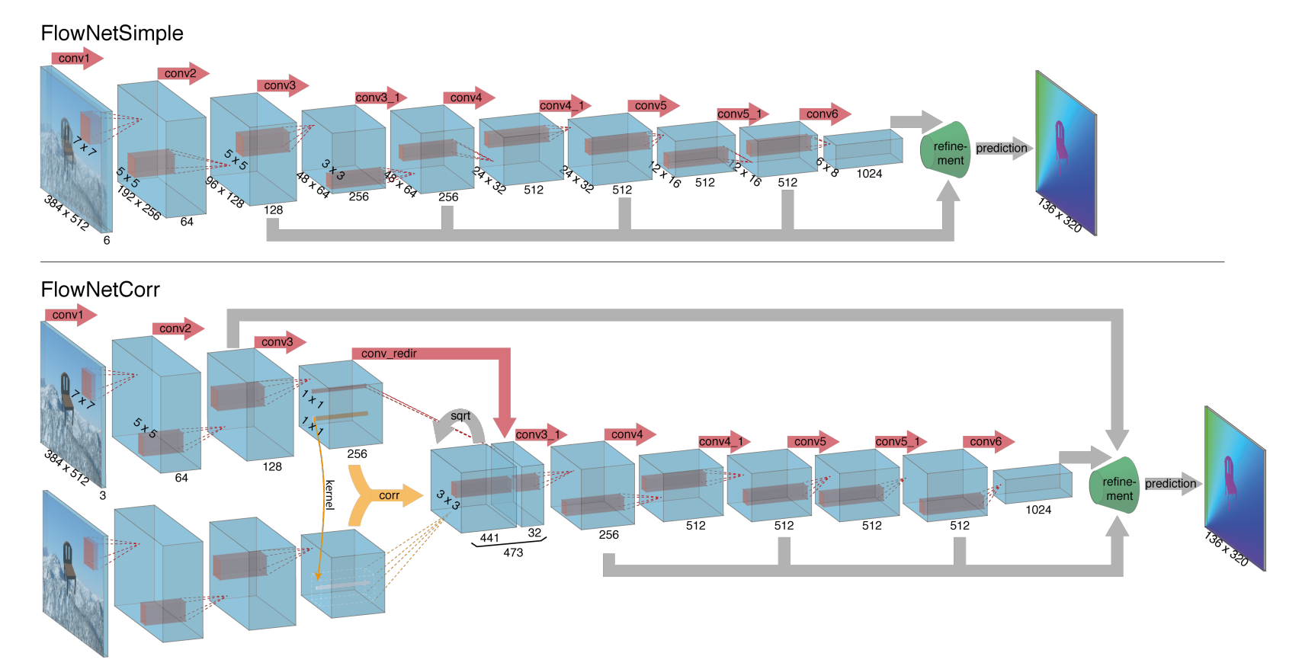
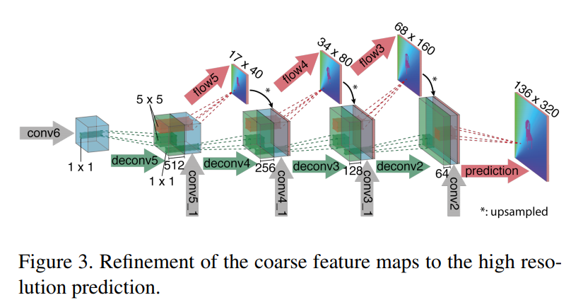
FlowNet
‘Upconvolve’ the whole coarse feature maps, allowing to transfer more high-level information to the fine prediction.
FlowNet: Learning Optical Flow with Convolutional Networks. ICCV 2015

Slide 25
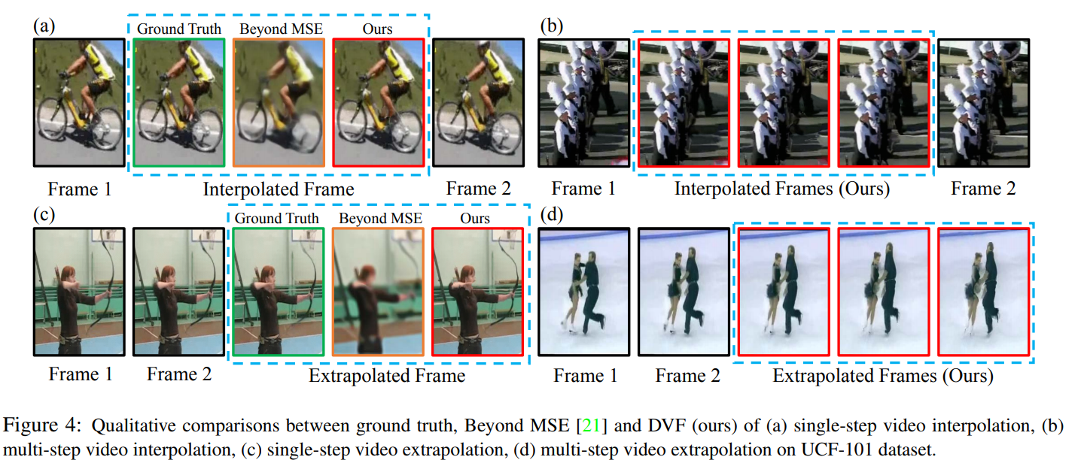
Video interpolation and Extrapolation
Video interpolation, i.e., synthesizing video frames between existing ones, is a common process in video and film production.

Slide 26
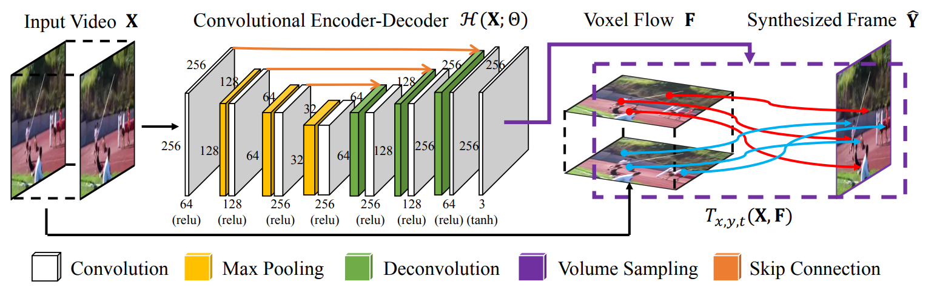
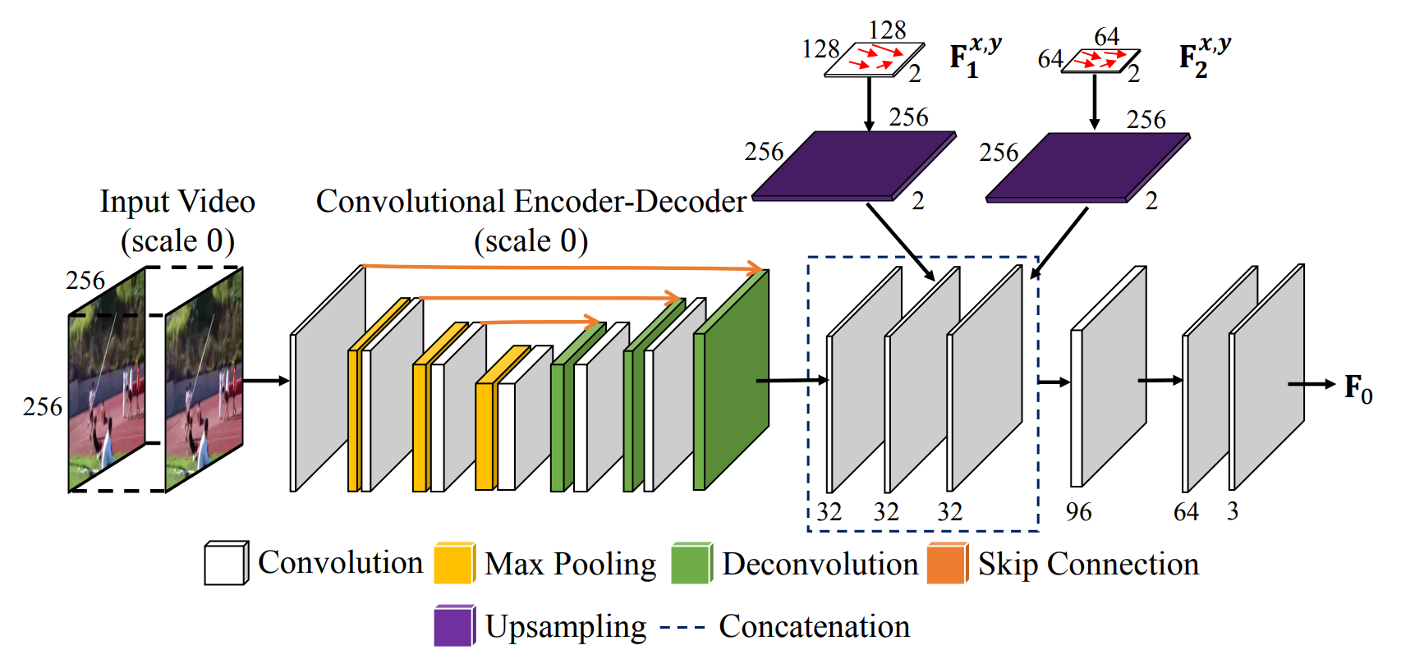
Video Frame Synthesis
Reconstruct a frame by borrowing voxels from nearby frames.
U-Net with coarse to fine network structure.
Video Frame Synthesis using Deep Voxel Flow. ICCV 2017

Slide 27
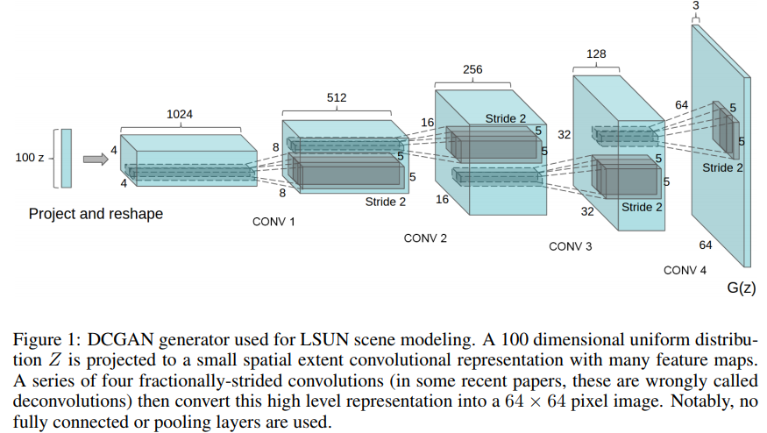
Generative Adversarial Nets
Learn more from the lecture
Unsupervised Representation Learning with Deep Convolutional Generative Adversarial Networks.

Slide 28
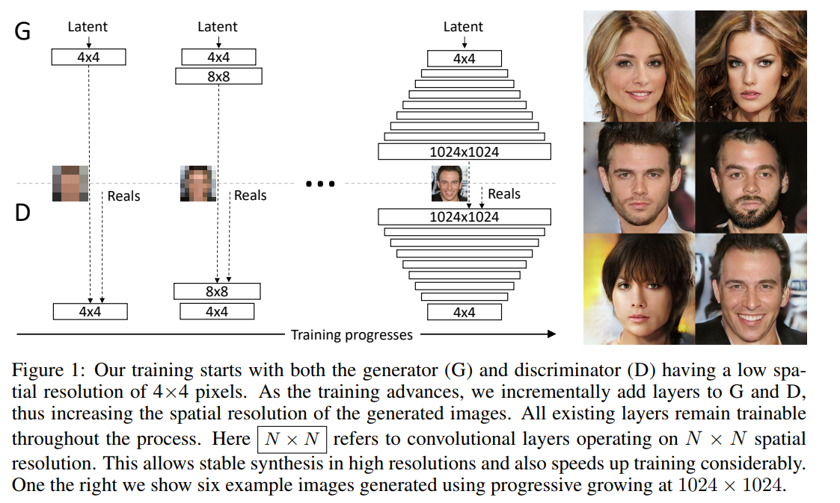
Progressive GAN Generation
PROGRESSIVE GROWING OF GANS FOR IMPROVED QUALITY, STABILITY, AND VARIATION. ICLR 2018

Slide 29
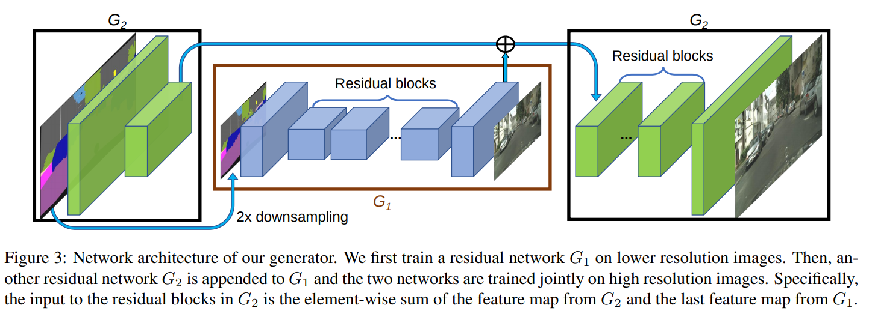
Pix2pix HD
Coarse-to-fine generator. Decompose the generator into two sub-networks: G1 and G2.
Multi-scale discriminators. Use 3 discriminators that have an identical network structure but operate at different image scales.
High-Resolution Image Synthesis and Semantic Manipulation with Conditional GANs. CVPR 2018

Slide 30
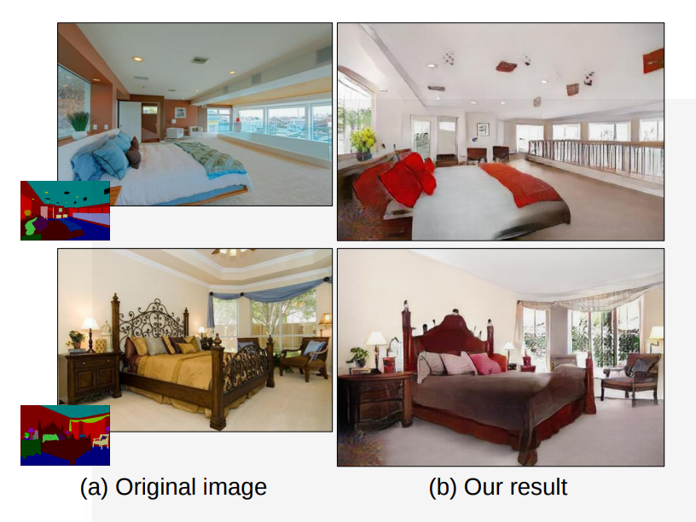
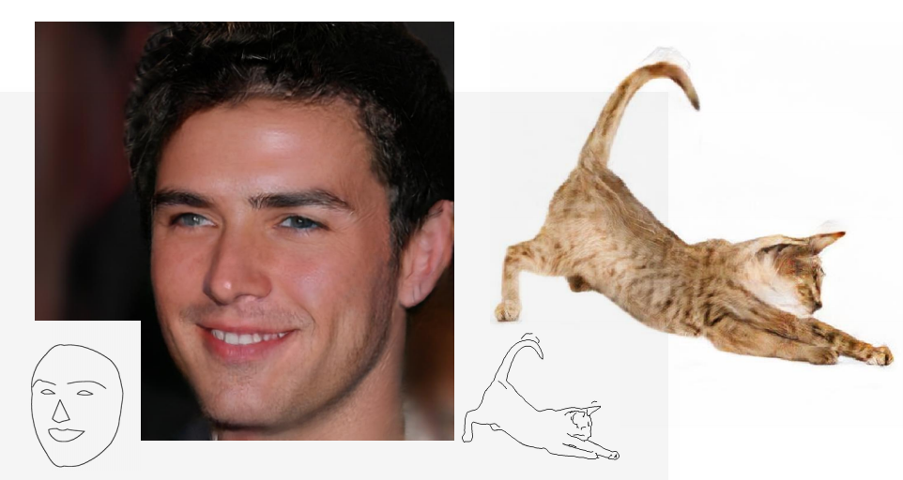
Pix2pix HD More Results

